Slide 1
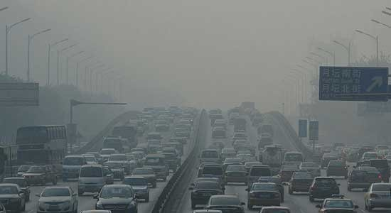
CUSP London Data Dive 2024 Group 5
Ikram Achak, Henry Cao, Juanes Lamilla, Kenneth Martin, Bohao Su, Michael Watson

Slide 2

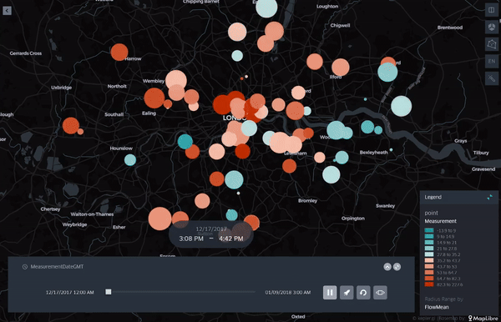
1] Q: Are there any other ways to measure or estimate air quality beyond setting up more monitors?
Pollutants
Air Quality data^{[1]} contains measurements for NO2, SO2, PM2.5, PM10
Vehicles-Emission
Congestion Scoot^{[2]} Data contains traffic throughput and capacity measurements.
Wind-Spreading
Weather Condition^{[3]} Data contains wind speed, wind direction, humidity, and temperature
Spatial-Related
Shapefiles includes boundaries of wards and MSOAs in London
How can we provide some predictive value to people who lives in wards where no monitors are nearby?
Validate the correlations among above variables do exist
Try different models: PLS, SARIMAX, LSTM
Draw some qualitative conclusions among the variables
Predict quantitative values of air quality
Explore spatial/geographical distribution patterns
Try to find causality behind those patterns
Provide some suggestions for decision-makers
The graphic on the right show variations of air quality (colour)
and traffic congestion (radius) over time
Notes:
Air quality important
We need to measure it without additional infrastructure requirements
We aimed to find relationships between air quality and other better measured factors
Only about 100
Say how we combined sensor data

Slide 3
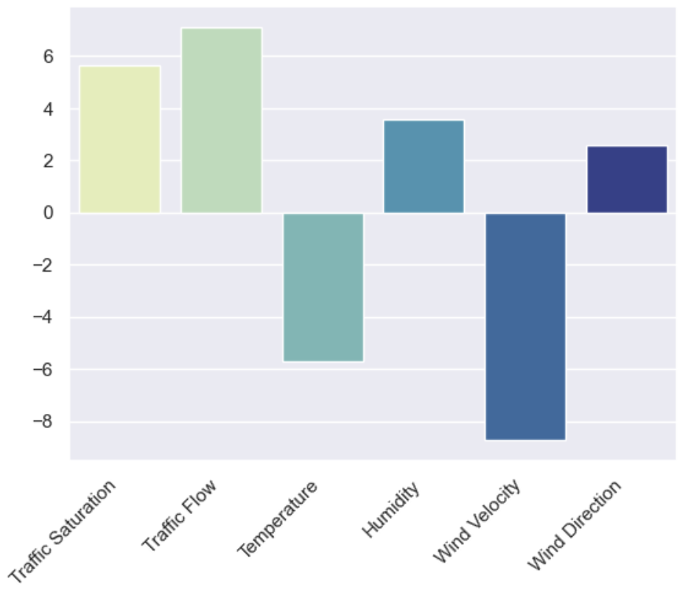
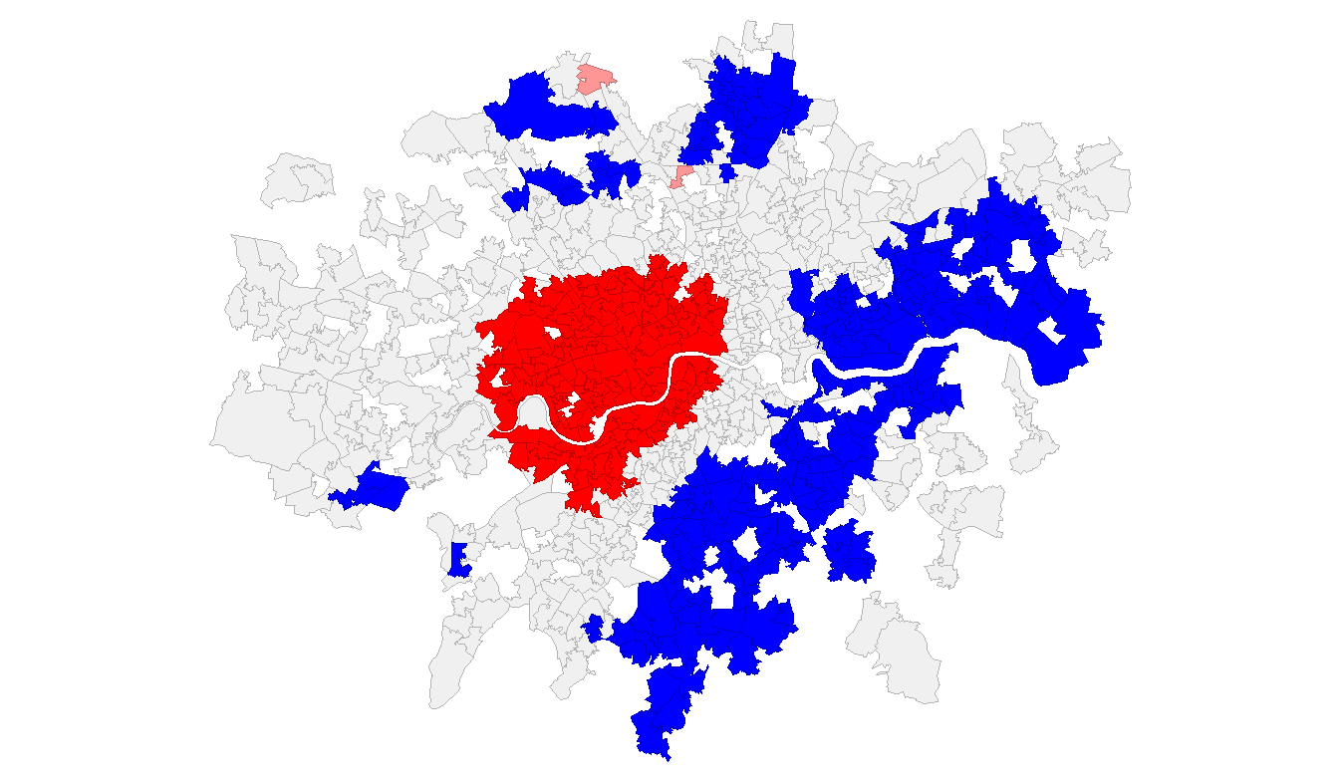
2] Concise summary of the outcome and recommended actions.
Summary of the outcomes
The PLS model shows that traffic congestion directly affects NO2 emissions levels.
Our model can be used to geographically isolate MSOA’s (Middle Layer Super Output Area) with NO2 emission levels that exceed EU standards.
Recommended actions
Decision makers can thus target MSOA’s with higher levels of NO2 emissions instead of implementing policies across entire boroughs.
If this model is made public, people can be informed about pollution levels in their local area, as well as learn about how pollution is monitored.
Limitations and caveats of our approach include:
Short data time frame of 3 months
Limited overlap between air quality and traffic congestion monitors
Weather data not localised to specific monitors
Distances measured using Euclidean distance instead of
following distances along streets
Relative importance of model input features. Traffic flow and saturation are of high importance and are controllable.
LISA Cluster Map of Mean Pred. NO2 by MSOA
Notes:
Perhaps recommended actions
More ulez?
More cycling?

Slide 4
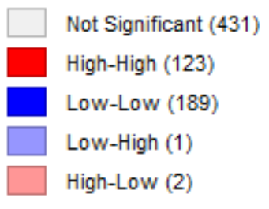
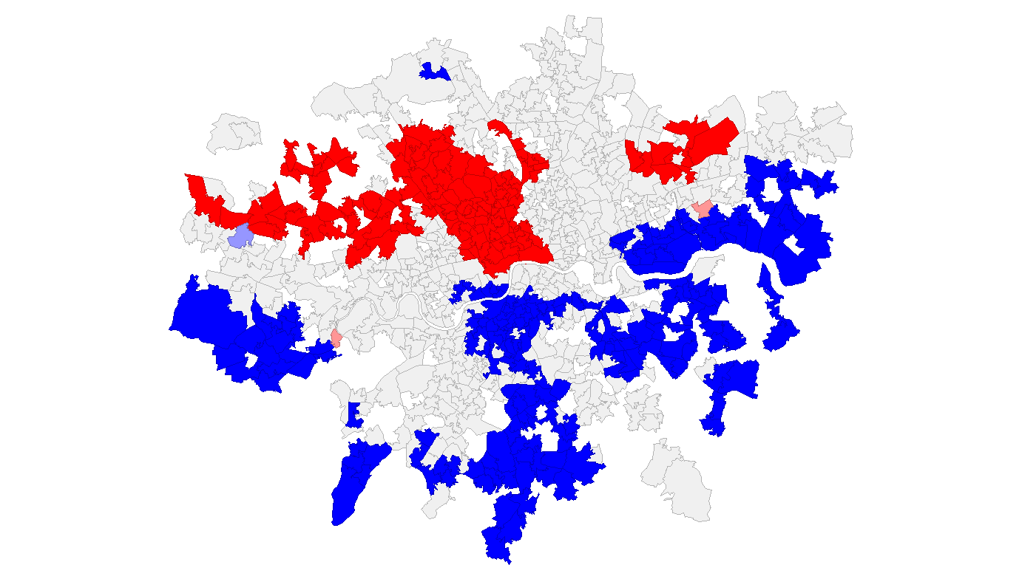
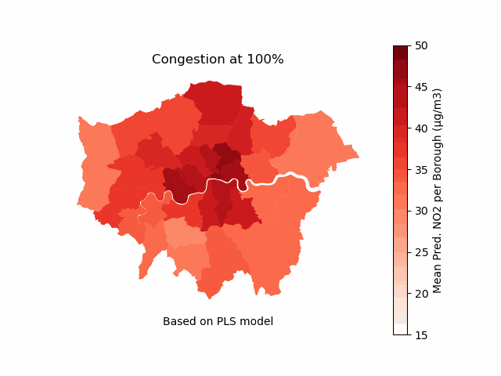
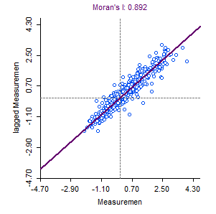
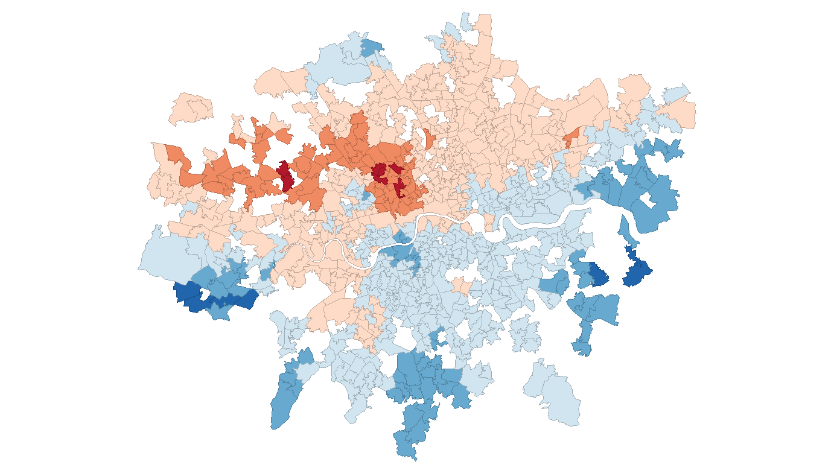
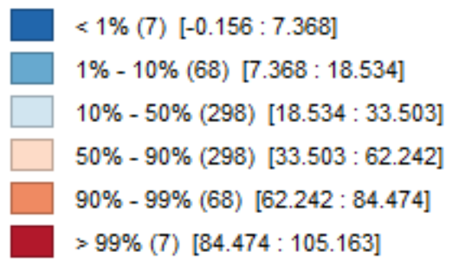
3] Graphical representation of technical information
LISA Cluster Map of Mean Pred. NO2 by MSOA for all single days
Predicted Percentile
Avg. of all days using PLS model
Single day using LSTM model — Friday March 16 - Moderate wind to the North

Slide 5
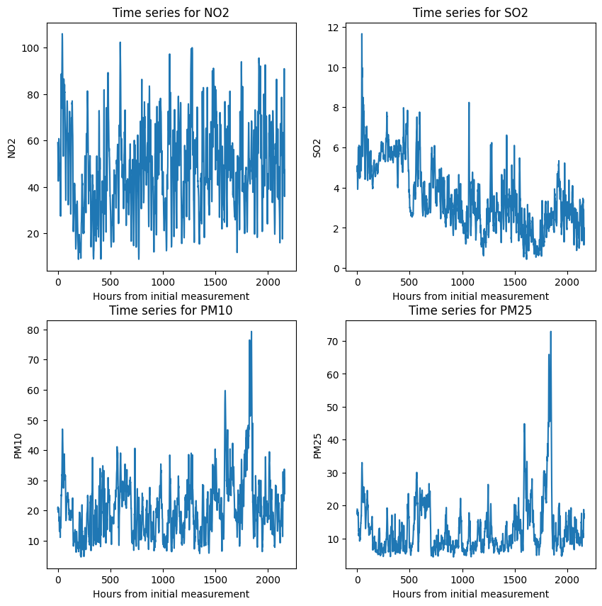
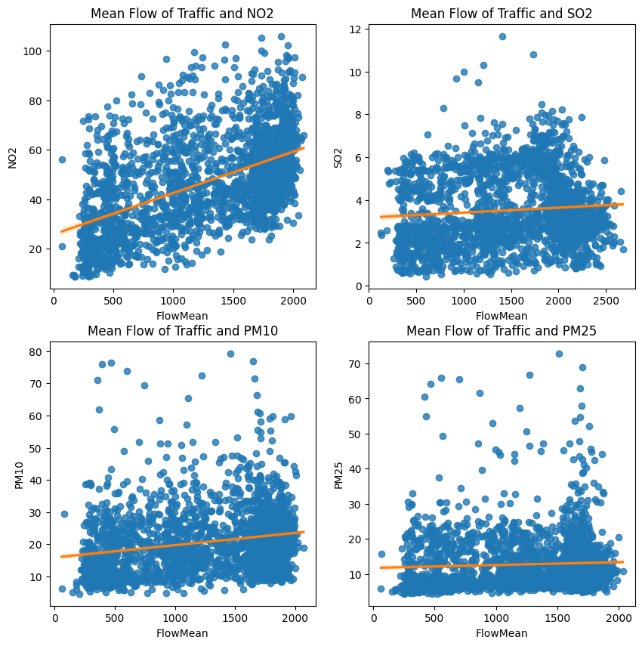
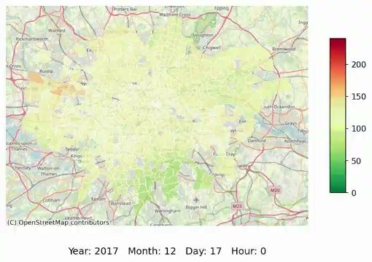
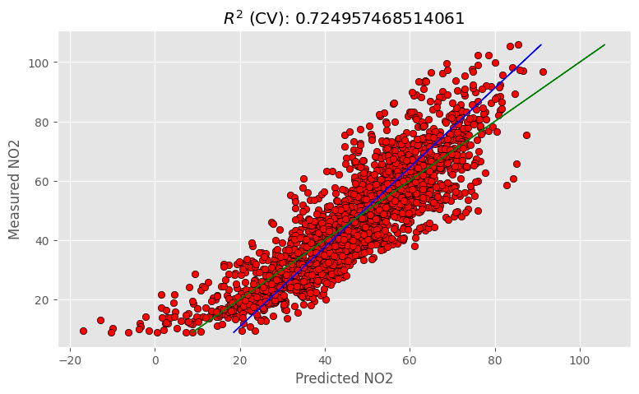
4] Additionals graphics and visuals
The pollutants fluctuate in a modular manner, controlled for by our model
Note the increase in pollutant levels as congestion rises
Our model fits the data to a high degree of accuracy.
Predictions of pollutants (NO2) modulated over time.

